Slide 1
Ask Me - A Document Question Answering System
19BEC1025 - A.V.N.M.Hemateja
19BEC1135 – K. Eswar Gowtham

Slide 2
Abstract:
Document Question Answering using Deep Learning Algorithms.
Due to covid, education is totally changed to online. So, students are highly depending on pdf ’s. we need something which does semantic search over our books/documents so that we can ask the question ‘How did the protagonist die?’e.t.c Which is regarding the context of the book.

Slide 3
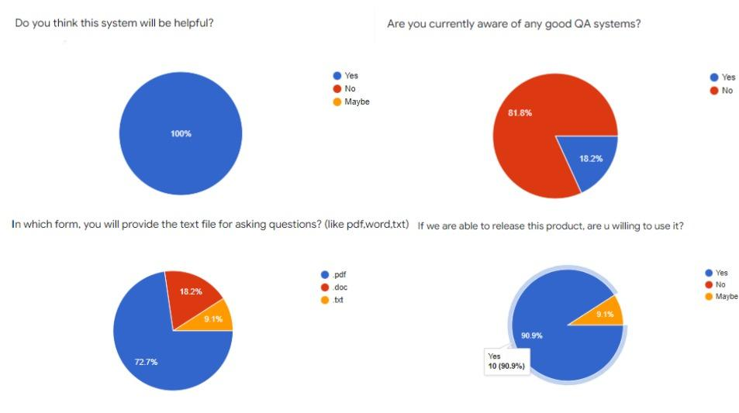

Slide 4
Aim: To process the given document and use deep learning algorithms to find the corresponding answer for the required question from the document.
Proposed Method: We will be using transformer based models called longformer and T5 Model (Seq to Seq Model) for processing the total text in the document and then we will be providing it with the question which will be answered from the document.

Slide 5
Document
PDF
txt
Extract Text
Preprocessing text
Preprocessing text
T5 Model (Seq to Seq)
Longformer
Question
Front End (User)

Slide 6
Software: We have used Tensorflow and Pytorch for backend development of Deep learning and we have used Stream Lit for building the front end of the web application with which client will interact with the application.
By the end of the web application, it will support txt, pdf documents.

Slide 7
Timeline: We have to make this model more robust for different types of questions that are more general than “who found blackhole?”.
Before Second Review -> Training Deep learning models and Pre Processing documents.
Before Final Review -> Frontend of webapp and plagiarism.

Slide 8
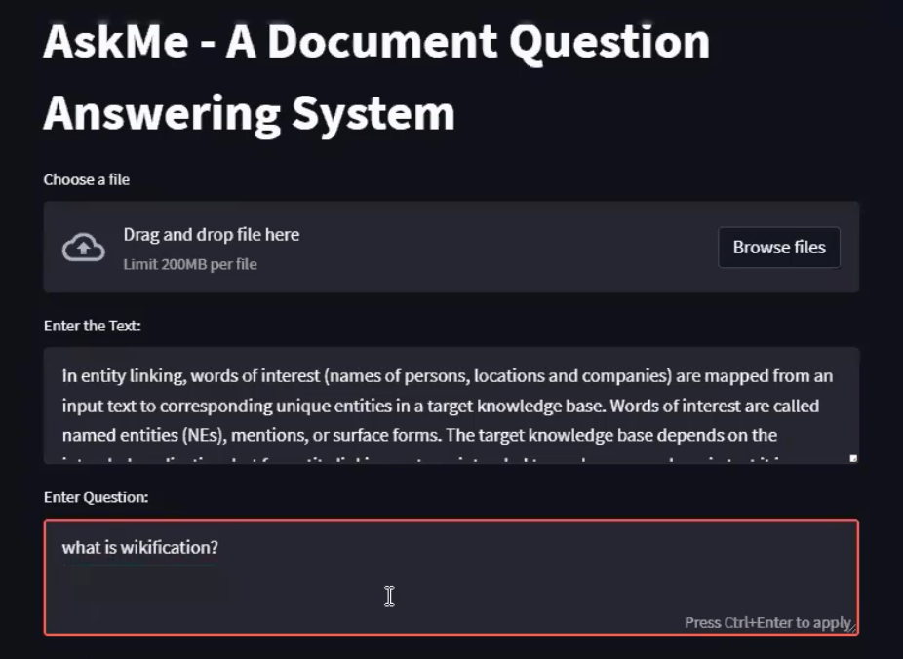
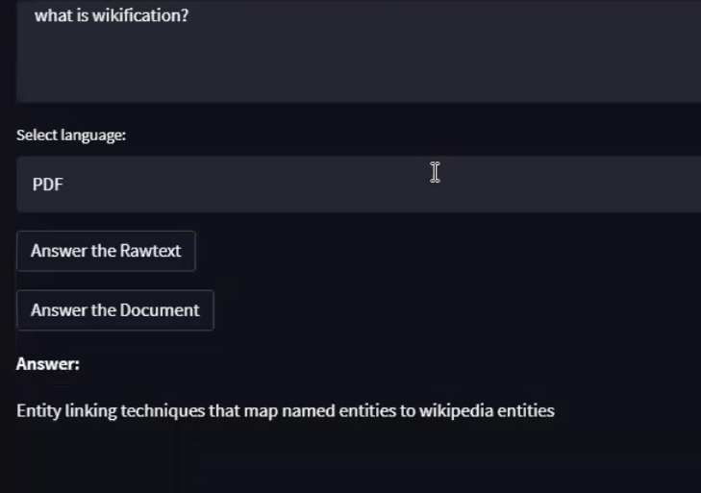
Results

Slide 9
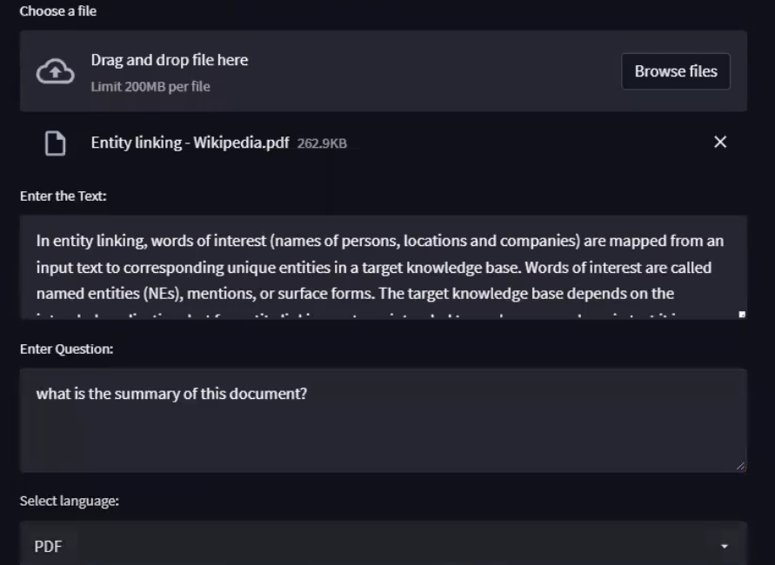
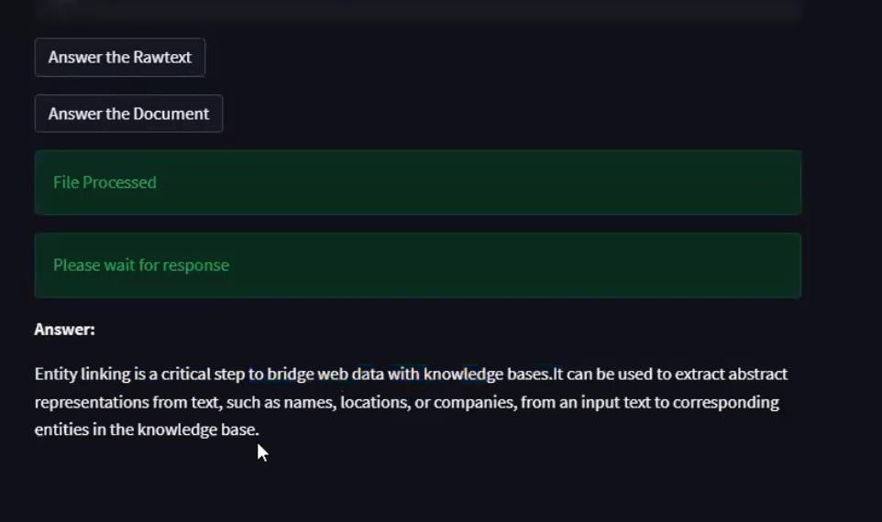
Results

Slide 10
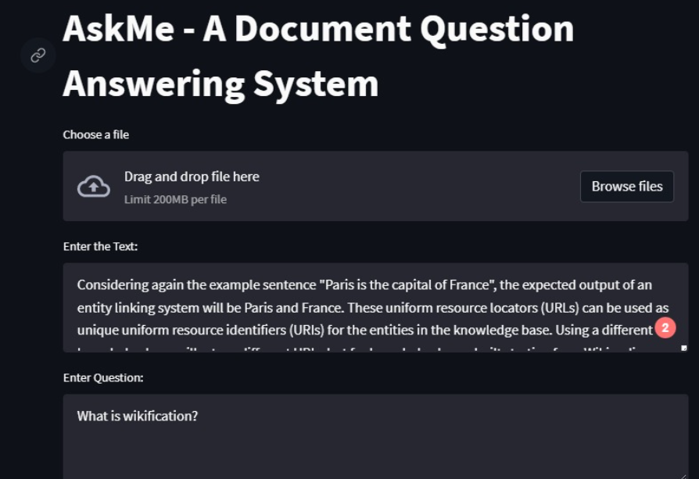
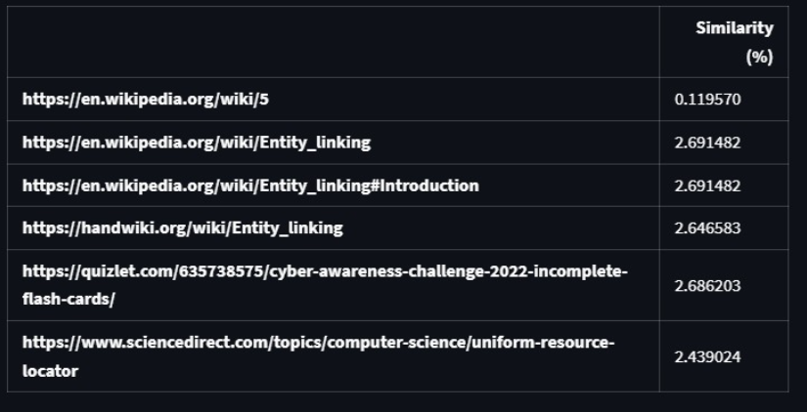
Results

Slide 11
References
References:
https://arxiv.org/abs/2004.05150
https://huggingface.co/docs/transformers/model_doc/longformer
https://rajpurkar.github.io/SQuAD-explorer/
https://arxiv.org/abs/1810.04805

